Slide 1
Nytlyf
Gary Straub & David Hanover

Slide 2
Problem: this place sucks
Ever been out with friends and bored out of your mind? Want to find a newer, more exciting place and arrange a ride there with minimal fuss? Nytlyf lets you do this.

Slide 3
Problem: We look at our phone enough
We all spend enough time staring at our phones during work and in bed. The last thing we need to do is stare at them while we should be having fun.

Slide 4
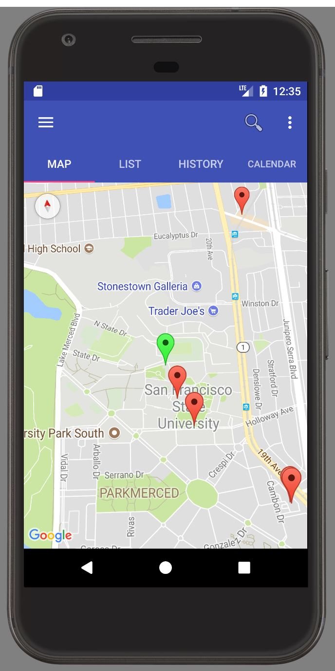
Open Nytlyf!
When you open the app, you will see a list of other bars and clubs near you.
The goal of Nytlyf is to cut out screen time when you should be having a great time. It is meant to be the fastest method in your phone for you to get from this spot to the next

Slide 5
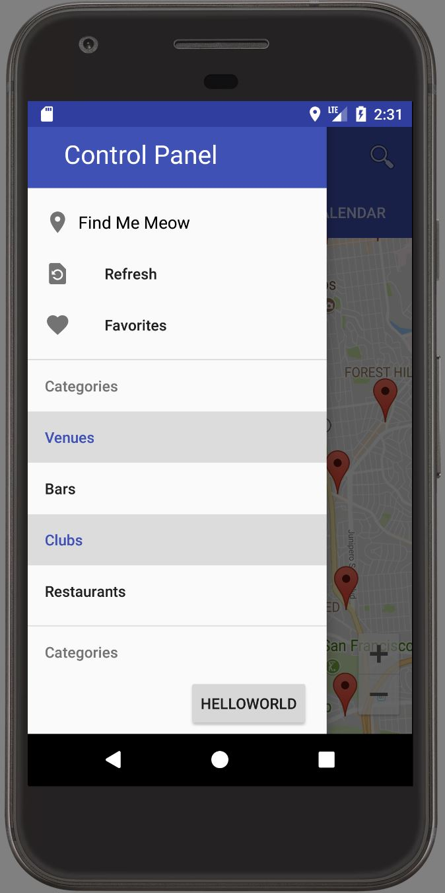
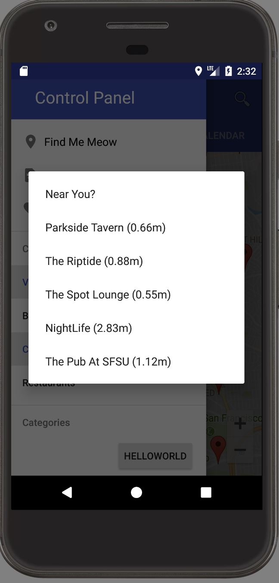
Settings menu
Opening menu allows you to specify types of places to filter
Find me now button allows app to guess where you are right now. Tapping one of the guesses takes you to that location’s detailed view page.

Slide 6
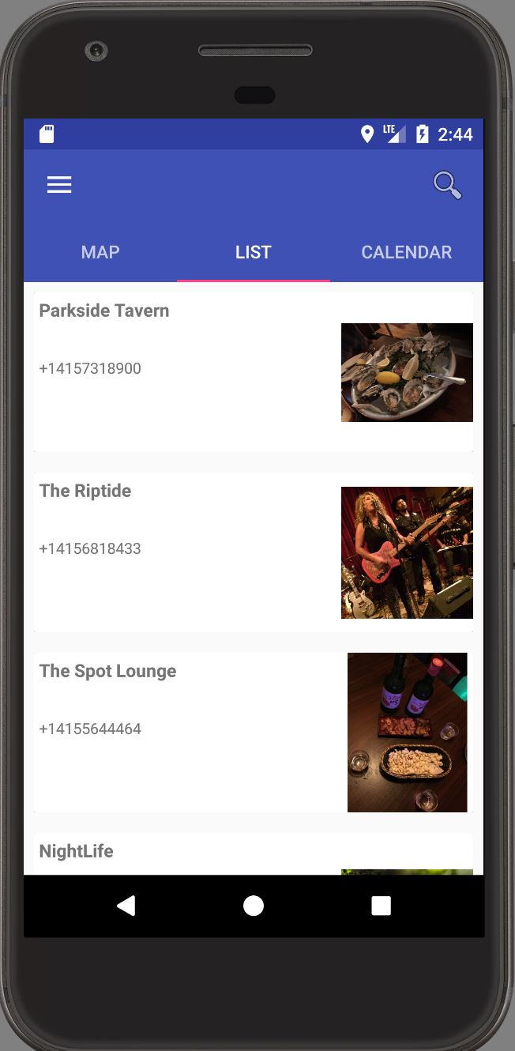
List View Tab
Another way to access venues is through the List View tab. Shows a list of all the closest spots to your current location.
Tapping a venue/bar brings up that place’s detailed view

Slide 7
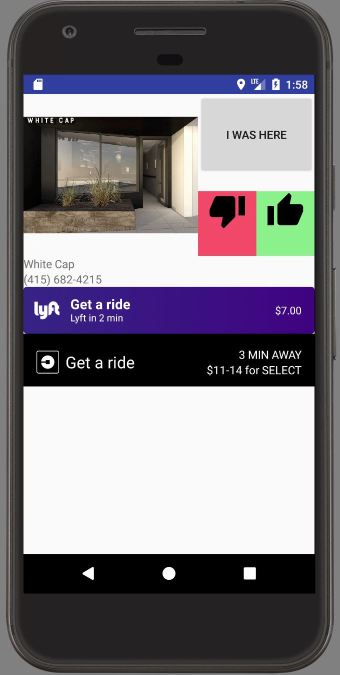
Detailed View
Allows you to call both Lyft and Uber!
Deep links to those apps when clicked.
Shows estimated wait time for a ride, as well as estimated price

Slide 8
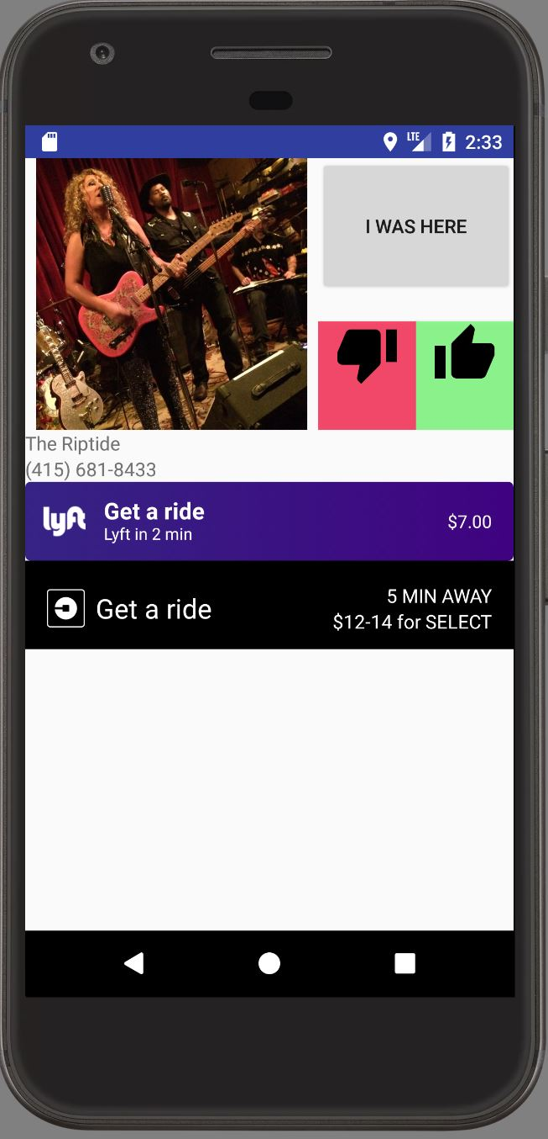
Detailed View Continued
Also prompts user to record either a like or dislike for certain places.
Tapping “I Was Here” adds this place to the User’s history.

Slide 9
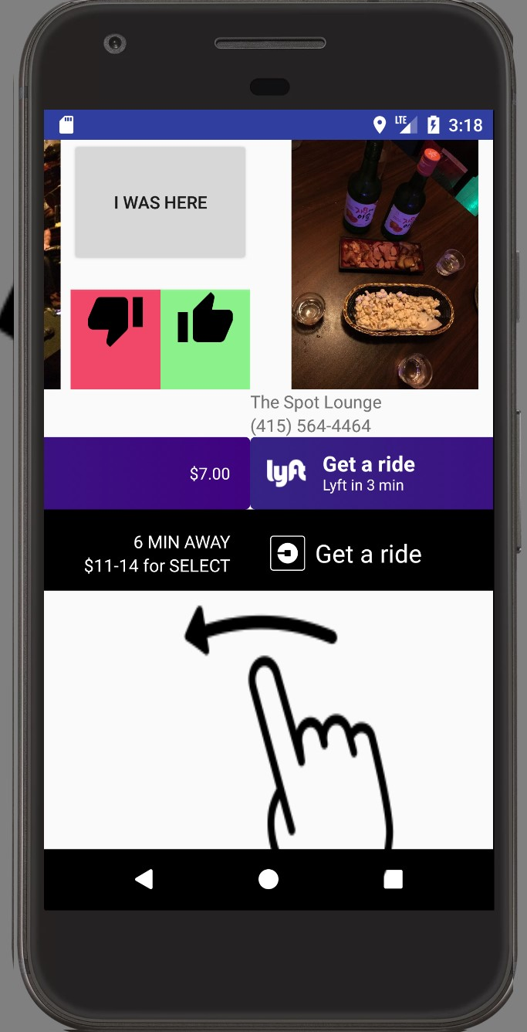
Swipe between places to go
Finding a new place is as easy as swiping to the side!

Slide 10
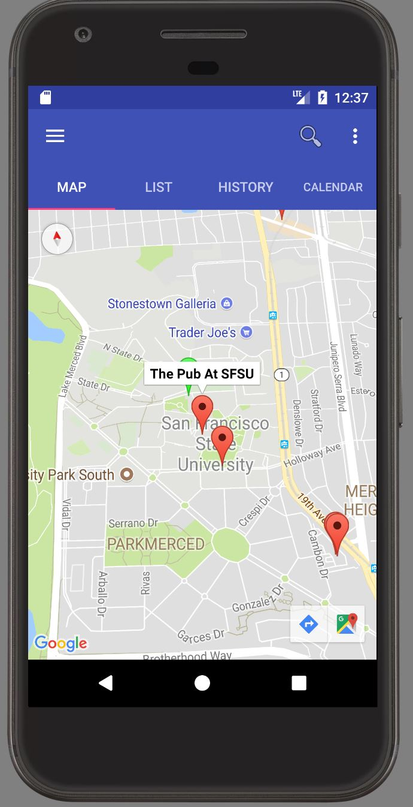
Tap a Marker
Tapping a marker will bring up the name of the place

Slide 11
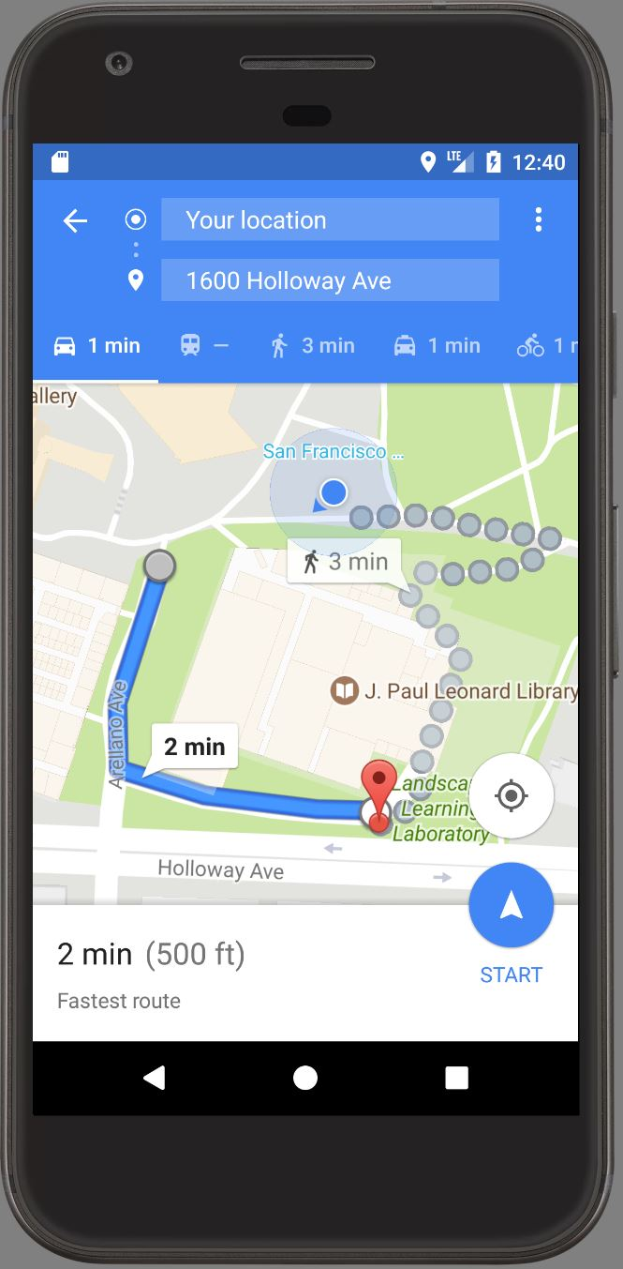
Walking directions
Tap the GoogleMaps button to deep link to GoogleMaps, bringing up walking directions!

Slide 12
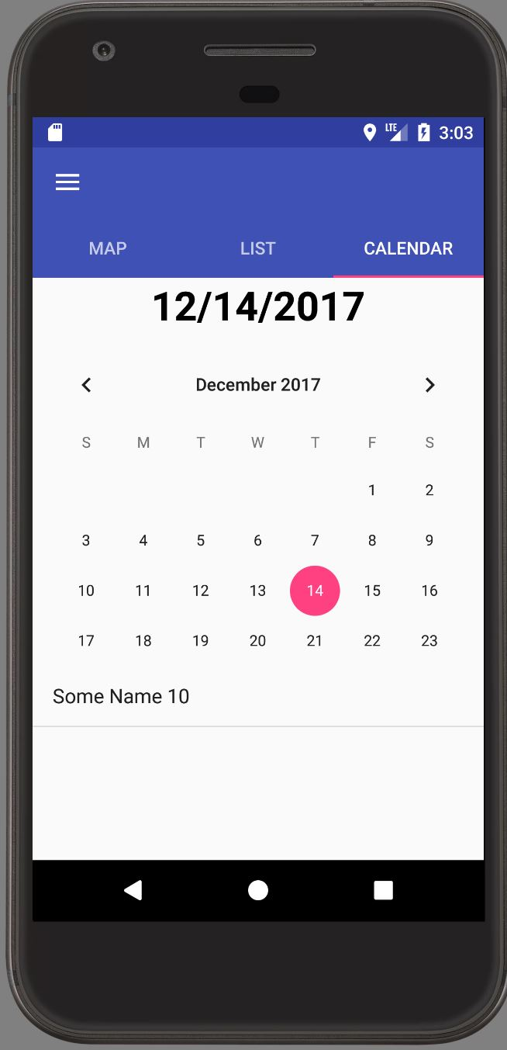
History Calendar
Had a long, foggy night that you can’t fully recall?
Want to remember exactly where your friends took you?
You can keep history of your night out on in this tab.
“Some Name 10” is placeholder for a bar/club. App is still in pre-alpha stage

Slide 13
Development Stack
We built this project on Android Studio, and had to utilize the GoogleMaps, Yelp, Uber, and Lyft APIs to get everything to work.

Slide 14
Planned Features:
We would like to add Facebook events to our map.
We want to add a Facebook check-in feature.
We would like to incorporate a suggestion algorithm based on other users’ likes and dislikes.
Finally, we want to incorporate user notes and meta-tags for each entry in their history

Slide 15
Thank you!
Hopefully using our app can get people away from their phones quicker and back into the nightlife!
Nytlyf
Gary Straub & David Hanover

